Slide 2

Slack Stealing Gordan Konevski

Slide 3
Real-Time Systems

Slide 4
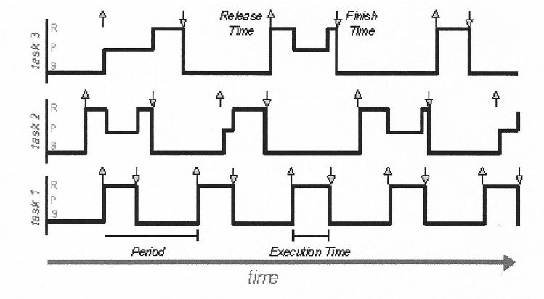

Slide 5
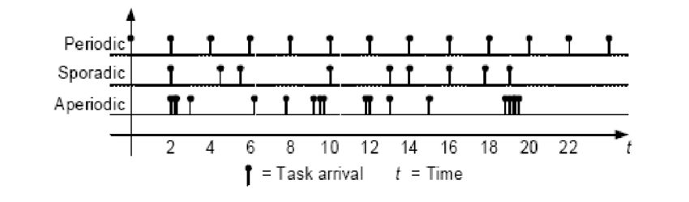

Slide 6
Technicalities

Slide 7

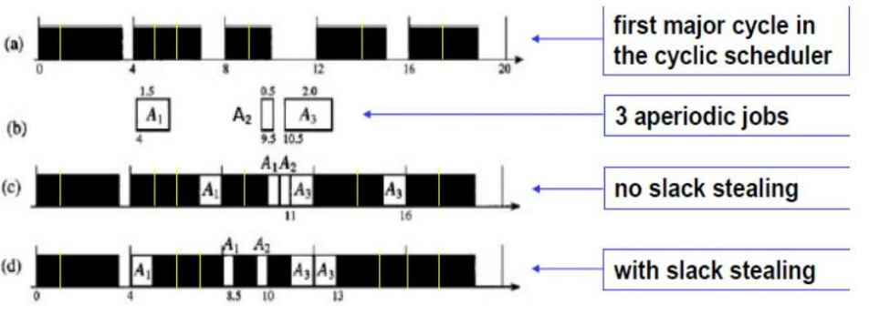

Slide 8
Fast Slack Method: An Example

Slide 9
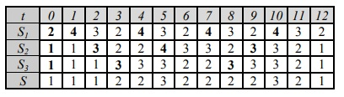
Using Counters

Slide 10
The End

Slide 11
Used Material
https://media.geeksforgeeks.org/wp-content/uploads/20200624095114/feedback.png
https://www.slideshare.net/AnilPokhrel5/slack-stealing-in-rts-ppt
https://www.researchgate.net/figure/Periodic-sporadic-and-aperiodic-task-arrival_fig2_336367207
https://www.researchgate.net/figure/Scheduling-plot-Three-periodic-tasks-are-running-on-the-same-CPU-tasks-1-and-3-having_fig1_228610754

